Slide 1
Improve I/O scalability for SDDP algorithm with MPI/IO/Lustre
Marcelo Cruz Diego Leonel Cadette Dutra – UFRJ Claudio Luis de Amorim - UFRJ
March 21th 2025

Slide 2
Outline
Introduction
Evaluation
Background
Solution

Slide 3
Introduction

Slide 4

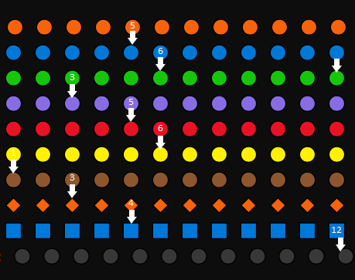
Introduction - The SDDP Algorithm
Temporal dependency.
The number of scenarios is the number of processes that can run simultaneously.

Slide 5

Introduction - The challenges after migration
Global warming.
About ten years ago, the electricity sector in numerous countries began a transformation process toward greater sustainability, with an accelerated increase in the participation of renewable power generators (mainly wind and solar) in their energy mix.

Slide 6
Background

Slide 7
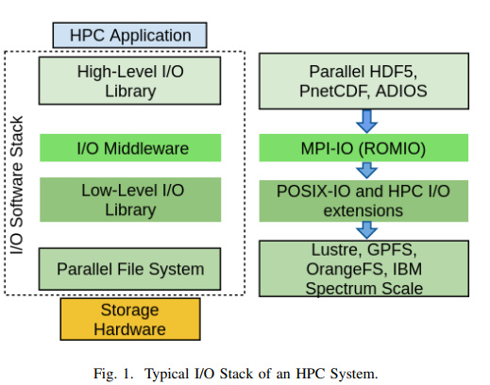
Background – Stack HPC

Slide 8
Background – HD5

Slide 9
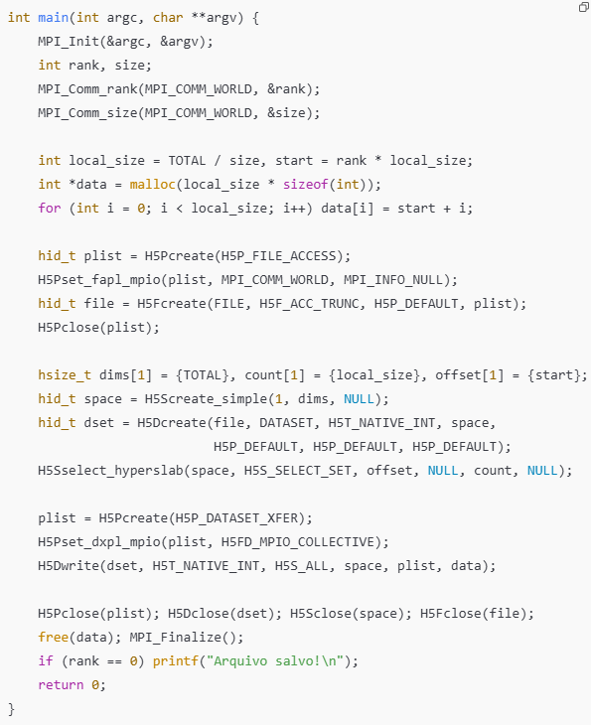
Background – HD5

Slide 10
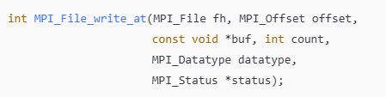

Background – MPI-IO

Slide 11
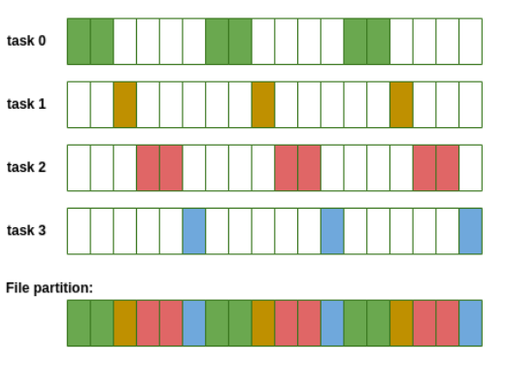
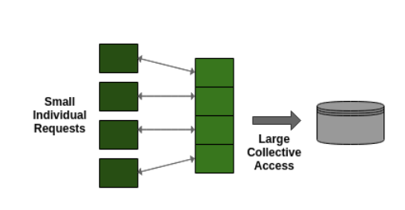
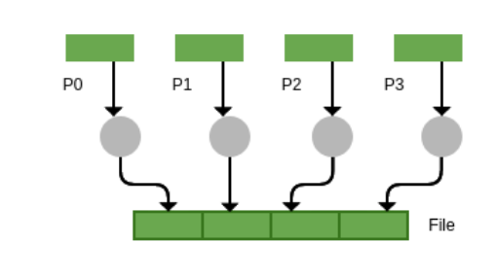
Background – MPI-IO

Slide 12
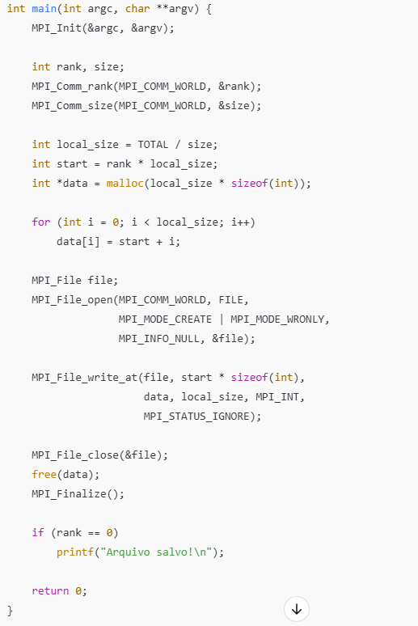
Background – MPI-IO

Slide 13
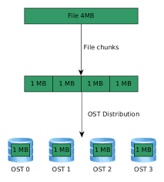
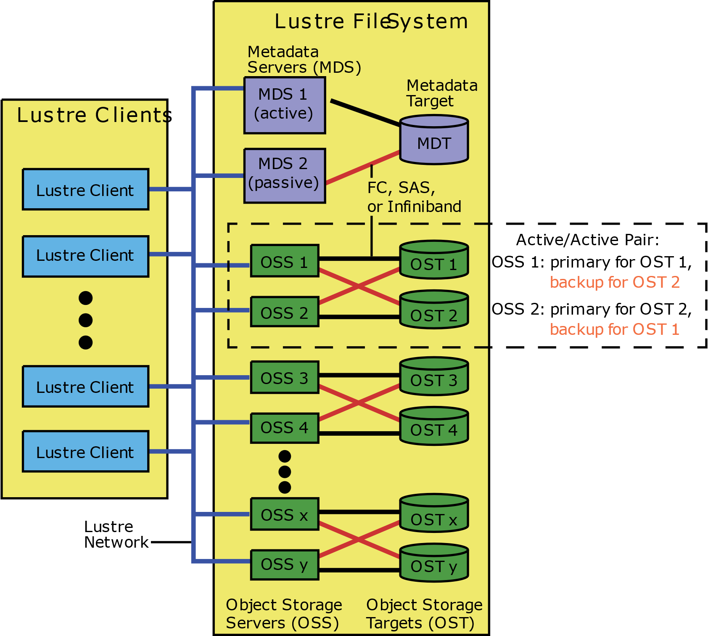
Background – LUSTRE

Slide 14
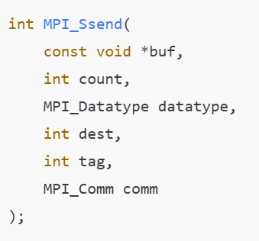
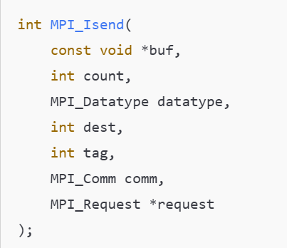
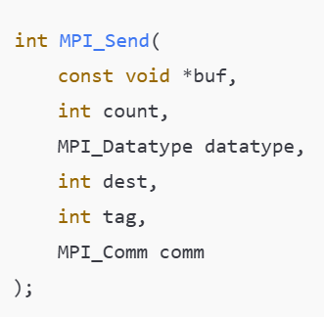
Background – MPI_Ssend , MPI_Isend and MPI_Send

Slide 15
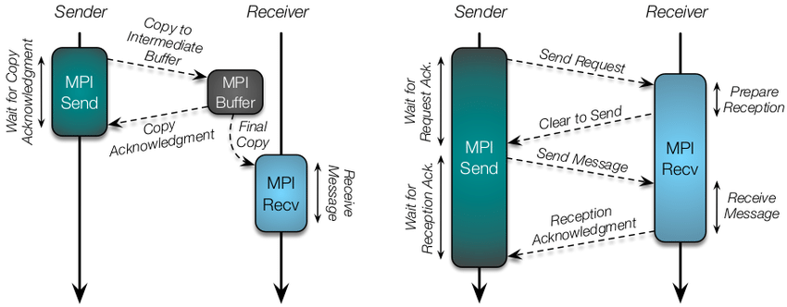
Background – Eager vs Rendezvous Protocols

Slide 16
Evaluation

Slide 17
Evaluation - case study
PMO BRASIL
Monthly: 1200 Scenarios
Hourly: 100 Scenarios
Memory-bounded ( 8 GB per process )
I/O bounded.

Slide 18
Evaluation - case study
16 nodes
Up to 3.2 GHz 4th Generation Intel Xeon Scalable processor (Sapphire Rapids 8488C)
32 Cores and 64 Hyper Theads.
64 GiB of ram memory per machine
Network bandwith 20 Gb/s

Slide 19
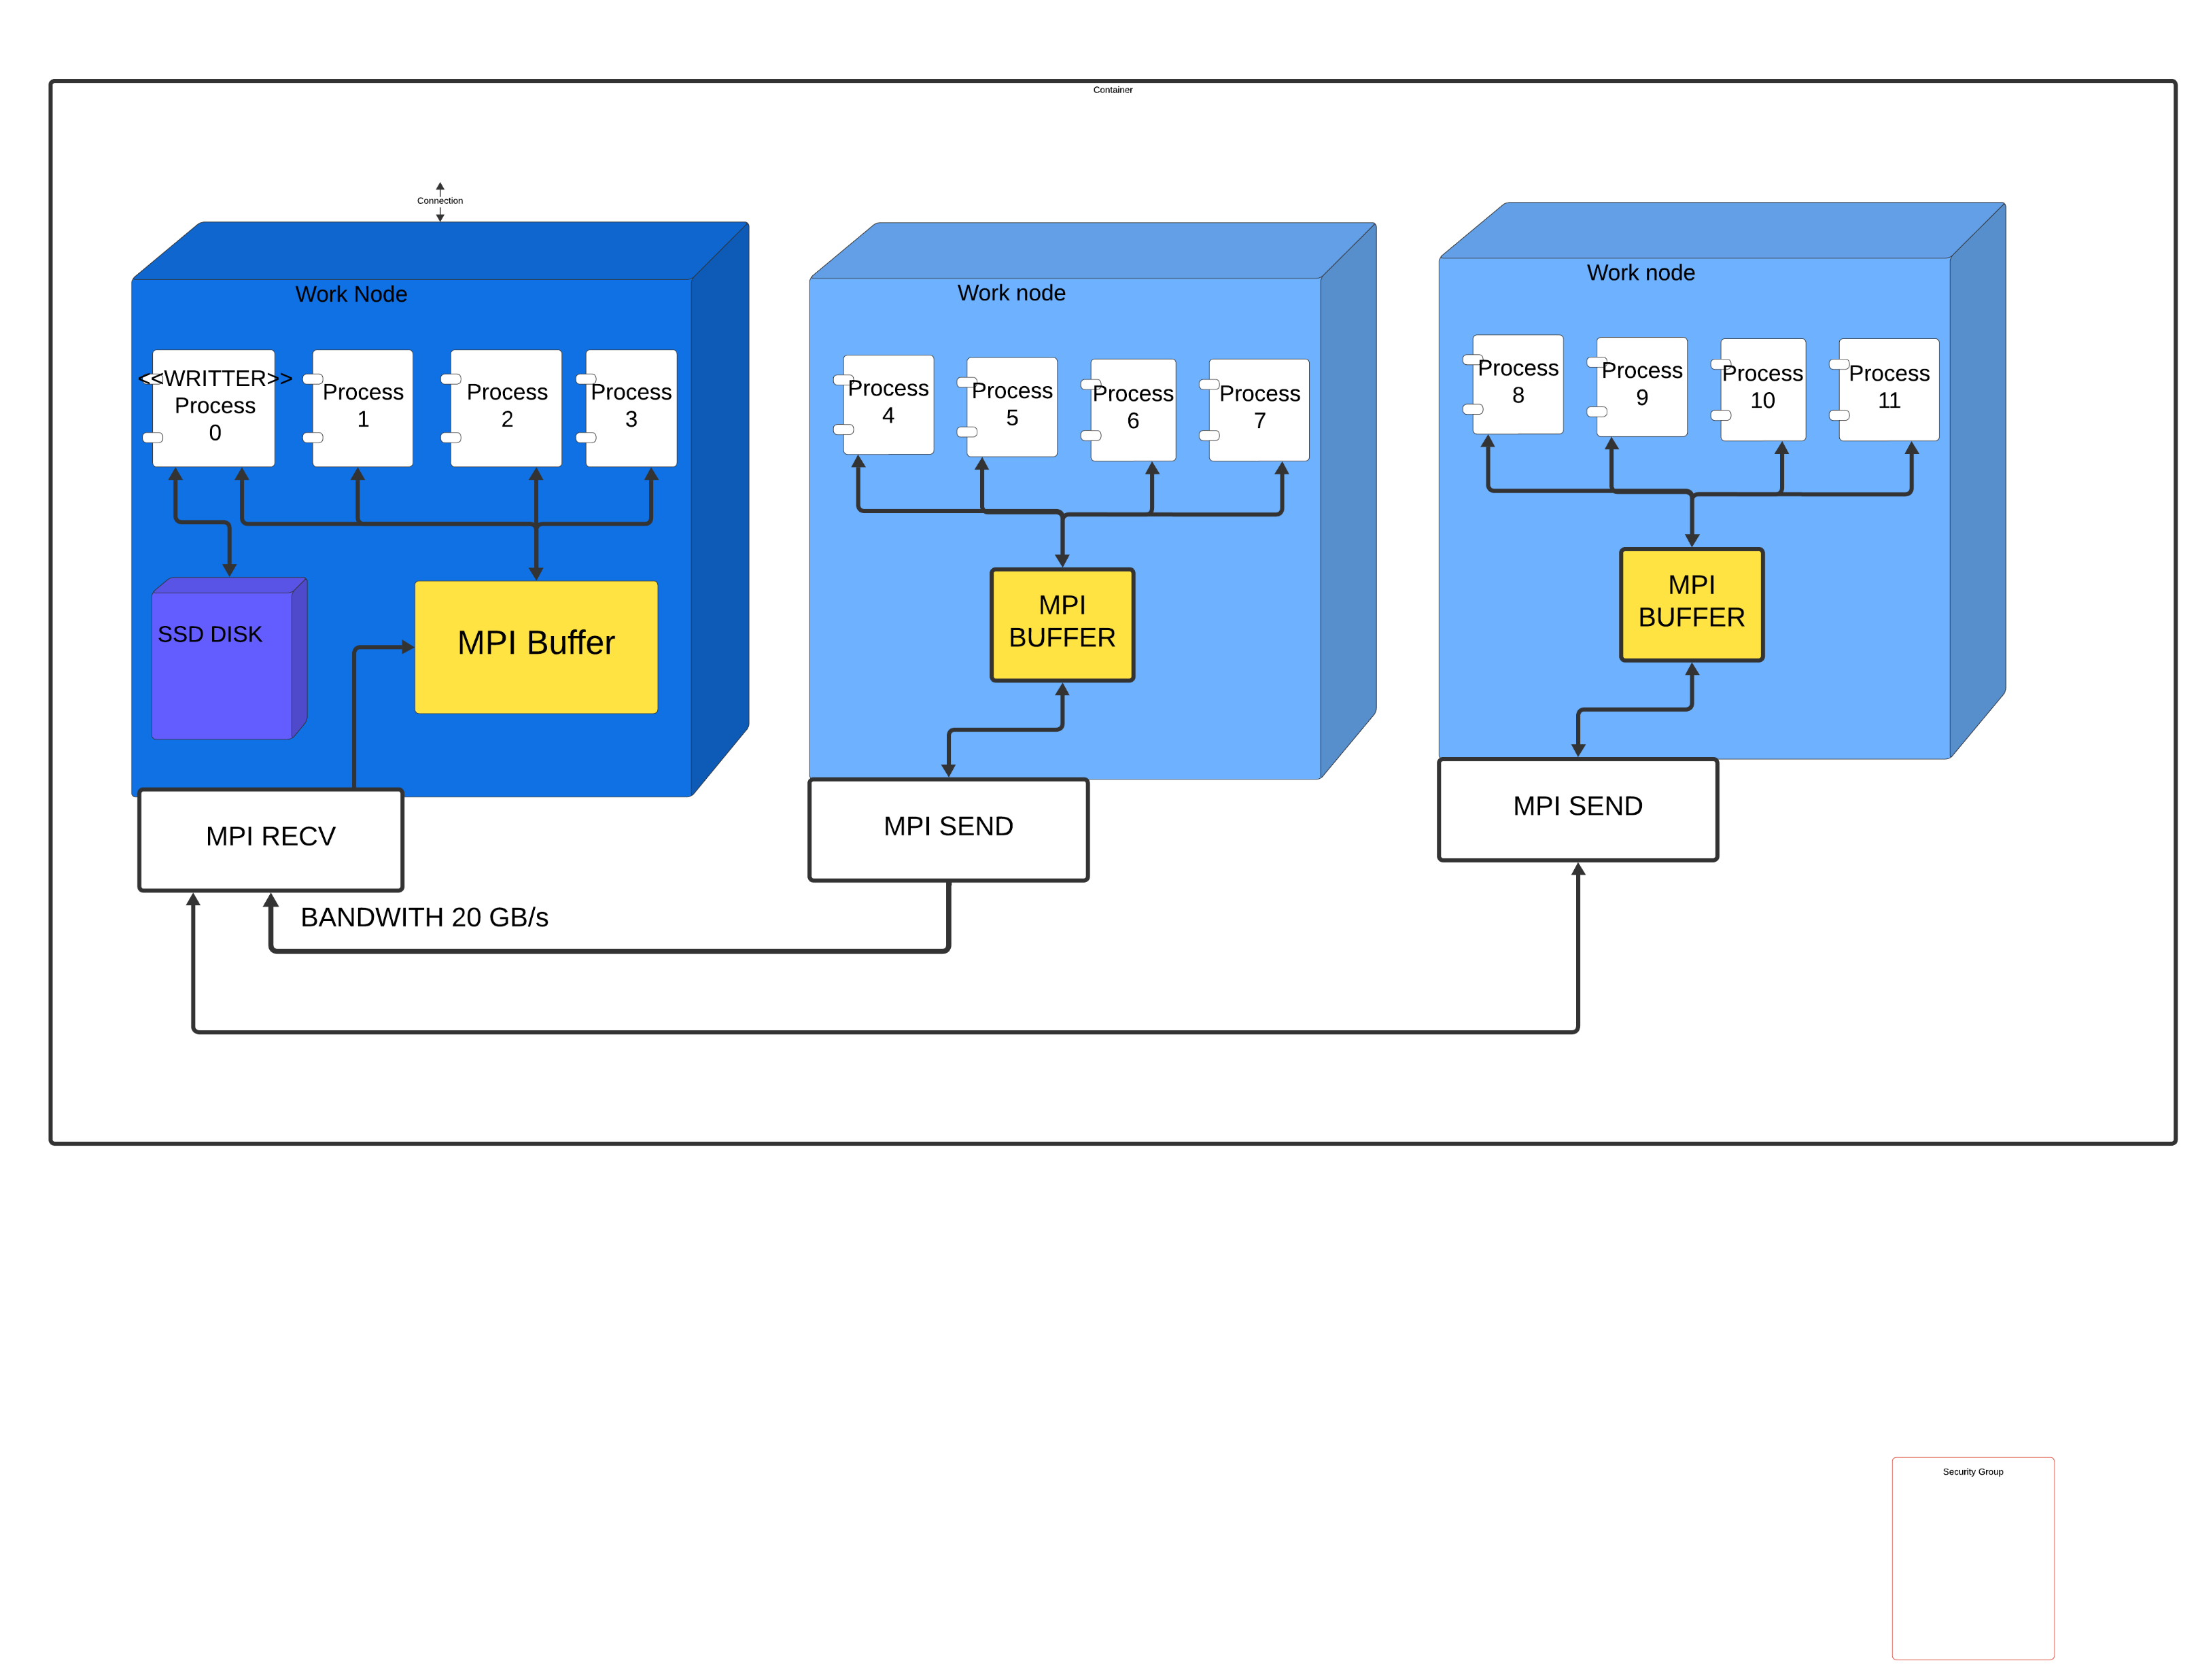
Evaluation - cluster architecture
Master Adapter Control Data and Results Data

Slide 20
Evaluation - The SDDP Algorithm
Test | Scenarios | Storage Size | Average(s) round-trip MPI | Stdev(s) | Comunication time(s) | Total time(s)
2 nodes | 12 | 40 GB | 0,000958 | 0,006271 | 0,285 | 2528,51
4 Nodes | 24 | 80 GB | 0,0049552 | 0,010698 | 1,473 | 2565,91
8 Nodes | 48 | 160 GB | 0,186381 | 0,460219 | 55,382 | 2772,69
16 Nodes | 96 | 320 GB | 0,884963 | 1,525884 | 262,898 | 3190,86
160 Nodes (*) | 1200 | 32 PB | - | - | 12800(*) | -
1600 Nodes (*) | 12000 | 320 PB | - | - | 128000(*) | -
(*) Estimate based on the bandwidth.

Slide 21
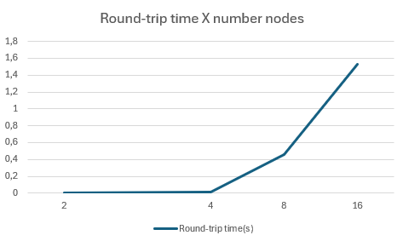
Evaluation – Round-trip time x number nodes

Slide 22
Solution

Slide 23
Solution – MPI-IO With LUSTRE
Increase scalability.
Reduce memory consumption of the Node Master.
Eliminate Central Node.
Works in the cloud and on-premises.

Slide 24
Future Work
Integrate MPI-IO aware Lustre.
Performance Tests with HD5.
Performance Tests with other PFS.
Performance Tests with NFS (ONS e EPE)
Performance Tests with Shotgun.

Slide 25




Thank you!
www.psr-inc.com
sddp@psr-inc.com

